Slide 1

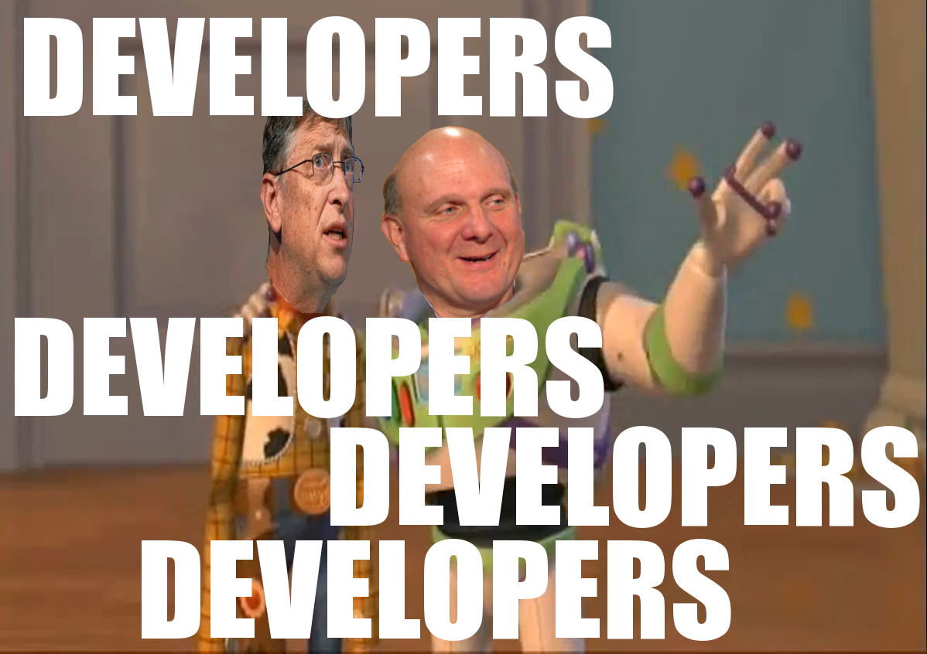
Who we’re looking for:
DEVELOPERS!
Both Frontend and Backend work available
No prior experience necessary
Functionality:
Replaces iClicker in classrooms with a modern web application
Cheaper, easier to use, more powerful, more fun!
Languages used:
Frontend: HTML, CSS, JavaScript, React
Backend: Express, MongoDB
Both: Docker, Git, Node
Current Status:
~75% of frontend pages are designed and implemented
Core backend functionality is built
Frontend-backend integration needs a lot of work
Contact:
PM: Hunter Harris
Email us: joinus@pollbuddy.app
Repos: GitHub.com/PollBuddy

